Slide 1
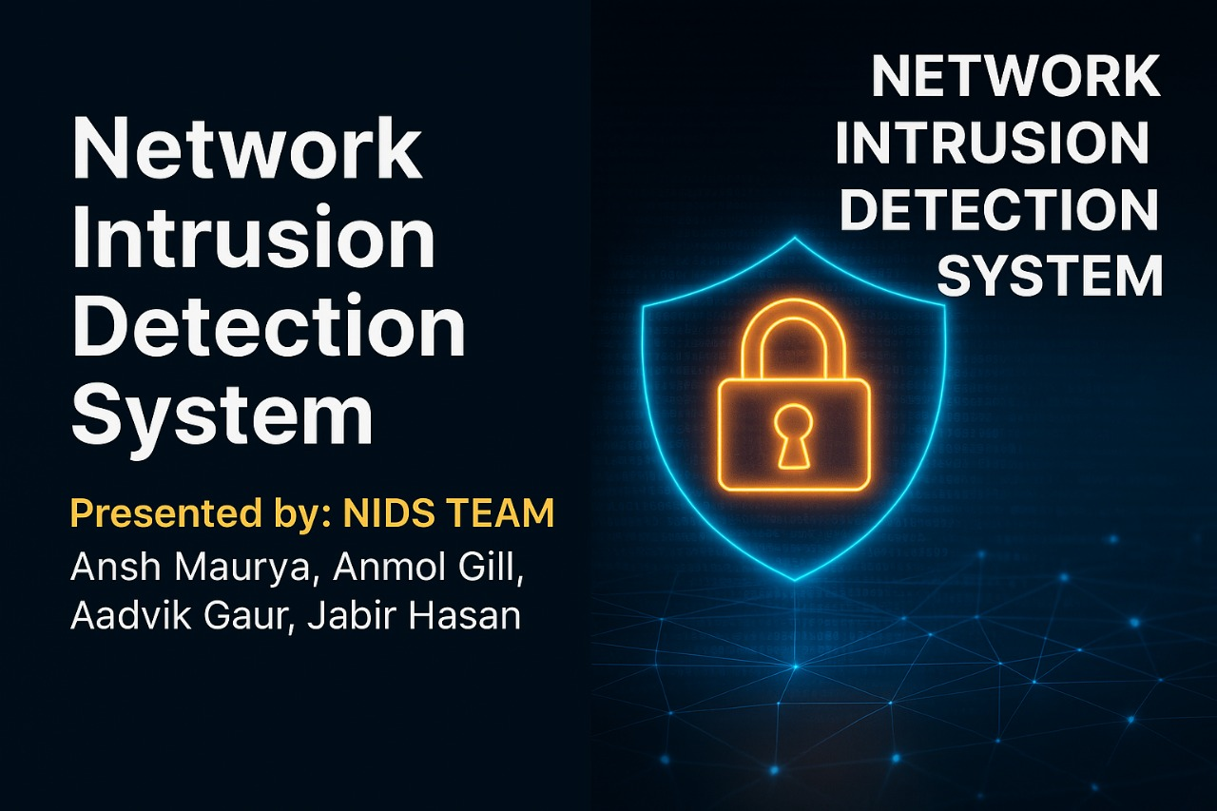

Slide 2
Intrusion Detection System Overview
Definition: An Intrusion Detection System (IDS) is a security solution that monitors network or system activities for malicious activities or policy violations.
Types of IDS:
Network-based IDS (NIDS): Monitors traffic on a network for suspicious activity.
Host-based IDS (HIDS): Monitors activities on individual devices or hosts.
Key Function: IDS systems analyze traffic patterns, system logs, and events to detect intrusions or abnormal behavior.
Outcome: Generates alerts to notify administrators of potential threats.

Slide 3
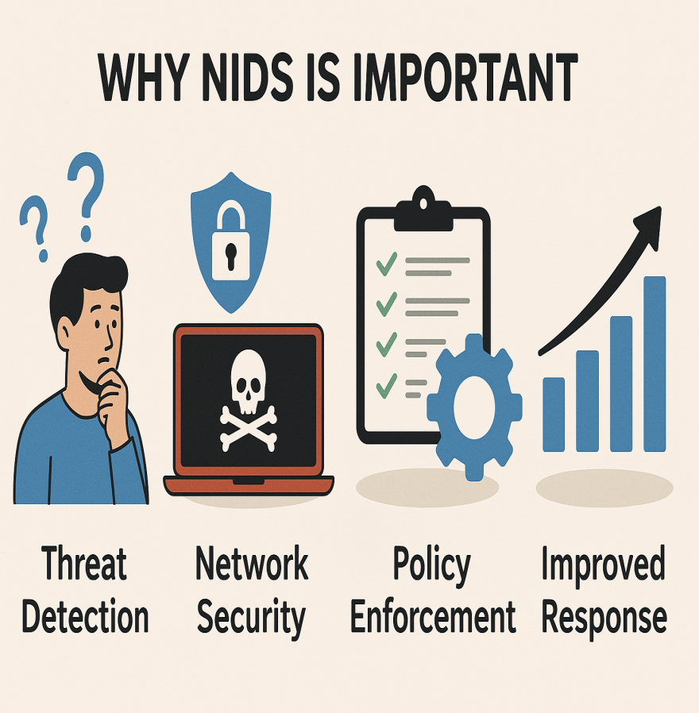
Why NIDS is Important ?
Detects potential threats early
Protects against data breaches
Complements other security systems
Improves network visibility

Slide 4
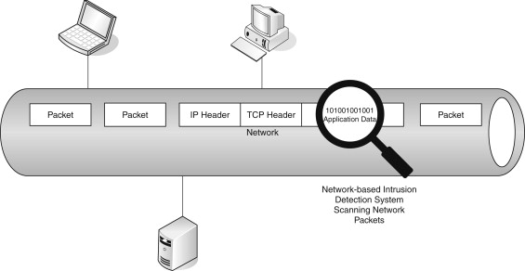
How NIDS Works ?
Step1:
Captures network traffic via sensors.
Step2:
Analyzes packets in real-time
Step3:
Matches patterns with known threats
Step4:
Sends alerts upon detection

Slide 5
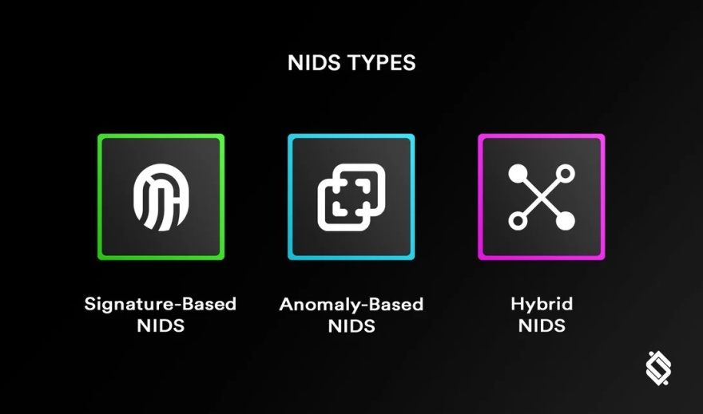
Types of NIDS:
Signature-based: Detects known threats using predefined patterns
Anomaly-based: Detects unusual behavior not matching normal traffic
Hybrid: Combines both methods for better accuracy

Slide 6
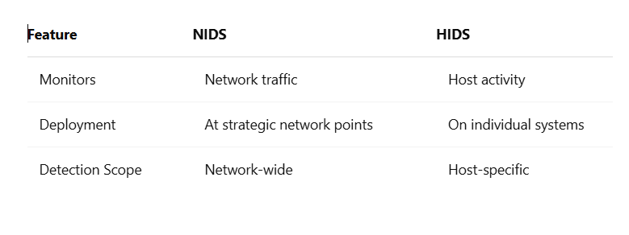
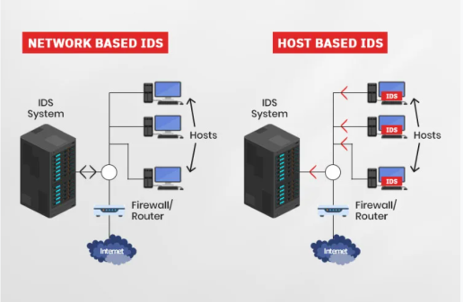
NIDS vs. HIDS

Slide 7
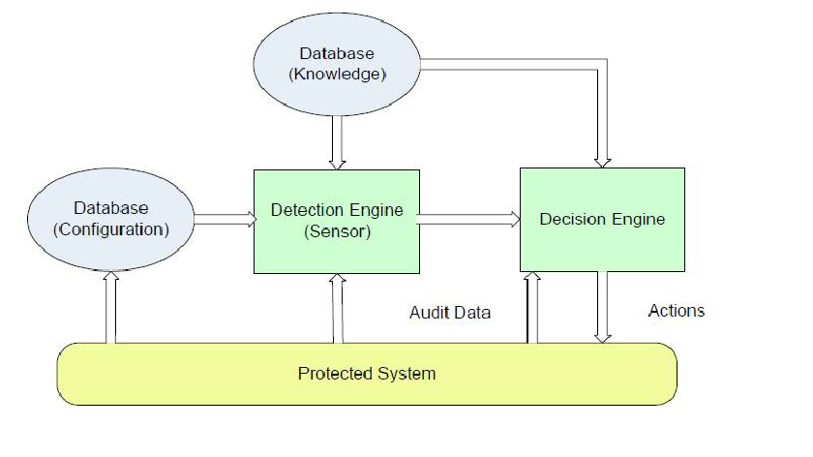
Components of NIDS
Sensors: Capture traffic
Analyzers: Inspect and analyze traffic
Management Console: Interface for monitoring and alerting
Database: Stores patterns and logs

Slide 8
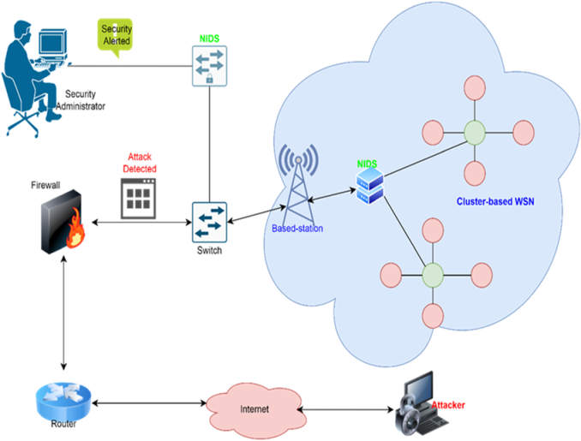
Deployment Strategies:
Perimeter-based: At network entry/exit points
Internal monitoring: Between critical network segments
Cloud-based NIDS: For cloud infrastructure security

Slide 9

Technology Used in NIDS
Packet Sniffing Libraries: libpcap (Linux), WinPcap (Windows)
Programming Languages: Python and its Libraries such as socket,
Sys, os, turtle & selectors

Slide 10

Challenges of NIDS !
High false positives
Encrypted traffic visibility
Performance overhead
Skilled personnel required

Slide 11

Future of NIDS
Integration with AI/ML for smarter detection
Improved encryption handling
Cloud-native and scalable architectures
Automation in response mechanisms

Slide 12
Conclusion
NIDS is vital for network security
Early detection prevents major incidents
Should be part of a layered security approach

Slide 13


